Slide 1


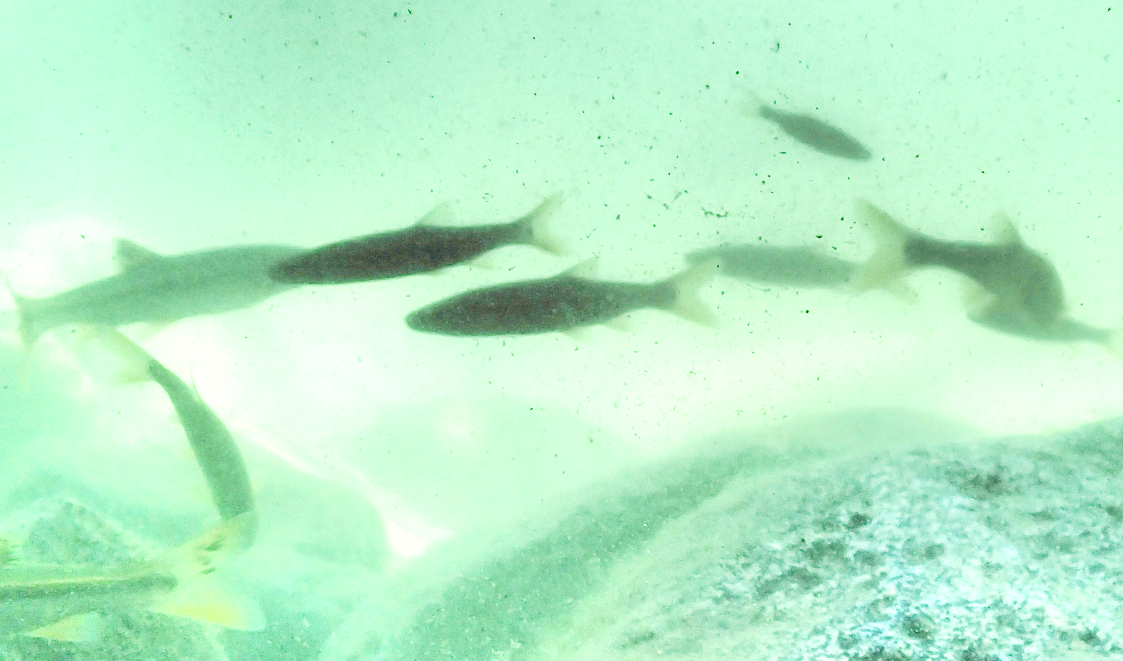
NCEPU / YTU
2021: Kick-off
University of Stuttgart
READ & ASSESS
Global change
Yellow River database
Rhine database
Global change
Hydrology & Ecosystems
2022
Morphody-namics & Ecosystems
Ecosys-tem pa-rameters
River database
Hydro-clim atic change
scenarios
GENERATE MODELS
Numerical model
Numerical model
Hydrological connectivity
Ecosystem performance
Ecosystem performance
Morphodyna-mic adaptation
2023
Hydro-morphodynamic optimization model
SYNTHESIZE & TEST MODELS
Costs for flow regime modification
Hydro-climatic change
scenarios
Costs for flow terrain modification
SYNTHESIS
Costs-efficiency comparison of hydrological and terrain modification

